Slide 1
Semantic Markup
Parker Zhou
parkerzho2010@gmail.com

Slide 2
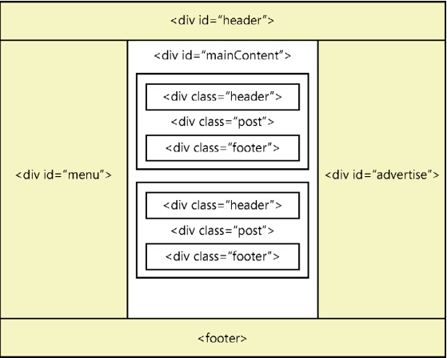
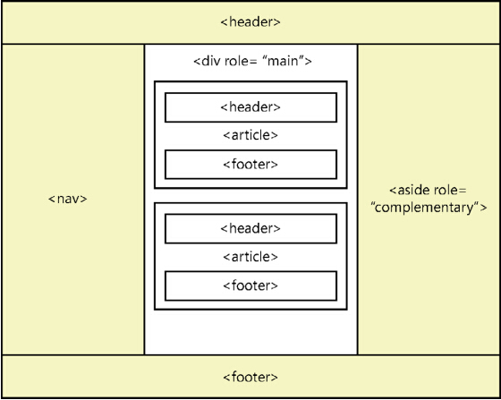
Semantic Layout
Notes:
Example

Slide 3
Semantic Text
<p>
You need to turn <strong>right</strong>.
</p>
<p>
Can you find a developer?
I <em>am</em> a developer.
</p>
<p>
<dfn>CSS</dfn> is short for <dfn> Cascading Style Sheets</dfn>
</p>
Notes:
you’d pronounce somewhat differently, with emphasis
denotes the definition of a term

Slide 4
Why Semantic?
Search Engine Optimization
Easy to read by machine
Notes:
Web crawlers

